Slide 1
Work-Based Learning
Work-based learning is an educational strategy that provides students with real-life work experiences where they can apply academic and technical skills and develop their employability.

Slide 2
Benefits of Work-Based Learning
Show improved academic achievement
Realize the relevance of their education and apply acquired knowledge in a meaningful way
Have the opportunity to explore career options
Increase self-confidence
Acquire real workplace experience and employability skills
Connect with an adult role model
Be more likely to go on to some type of educational training after high school

Slide 3
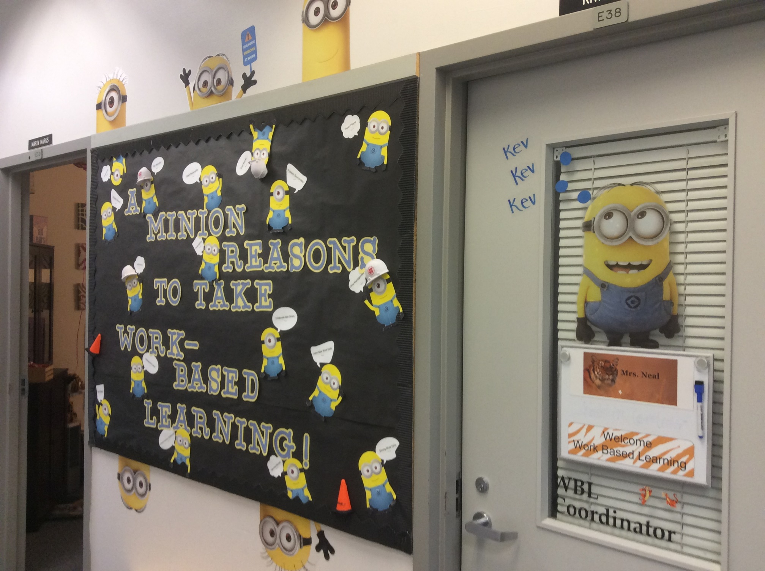

Slide 4
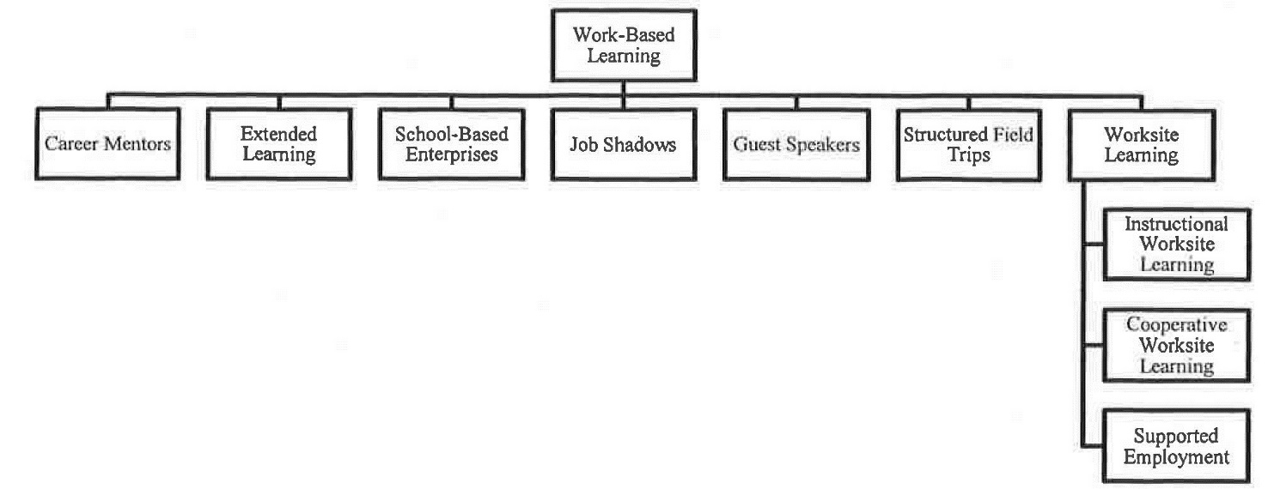
Types of Work-Based Learning

Slide 5
Instructional & Cooperative Worksite Learning
Instructional worksite learning is an extended learning experience in the community or school in an embedded part of specific course content.
Cooperative worksite learning is an extended learning experience in the community or school where students practice the skills and knowledge learning in the classroom through a “qualifying class”.

Slide 6
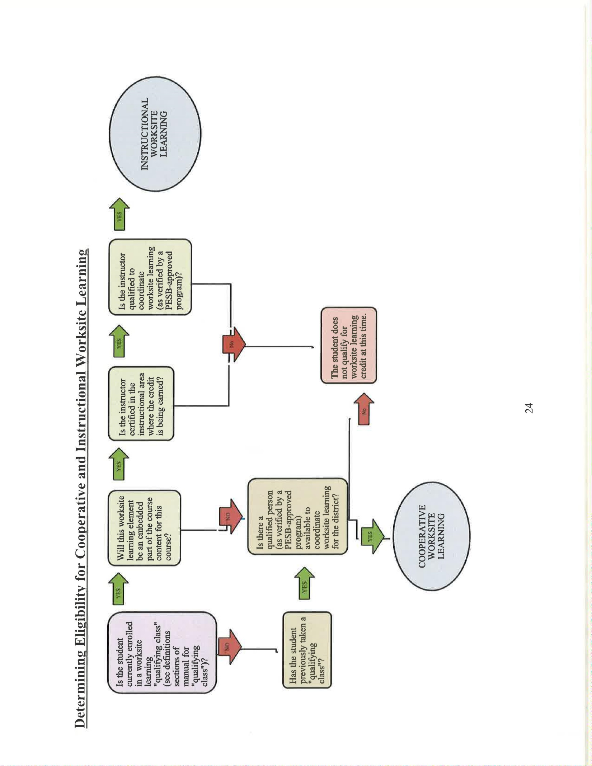

Slide 7
CIP Codes Qualifying Class
Student worksite learning placement is intended to build on /support the skills and competencies in their qualifying course.
Several qualifying courses may utilize the same CIP Code for the WSL Placement

Slide 8
Enrolling a Student
Cooperative Worksite Learning
Instructional Worksite Learning
At least 16 or older
Have taken or taking a qualifying class
Part of their HS & Beyond Plan
Learning agreement
Site Qualification Program Orientation
Student employer Orientation
WBL Student Learning plan
At least 16 or older
Enrolled in class that worksite experience is embedded in class
Part of their HS & Beyond Plan
Learning agreement
Site Qualification Program Orientation
Student employer Orientation
WBL Student Learning plan

Slide 9
Students can earn up to 3 Credits during their Junior & Senior Year
Junior
Senior
180 hours = .5 credit
360 hours = 1 credit
180 hours = .5 credit
360 hours = 1 credit
540 hours = 1.5 credit
720 hours = 2 credit
*Each district has their own Board policy on how to count WBL credits

Slide 10
Recruiting Work Site Learning Students
Counselors
Other students
Teachers
Business
Showcase @ 8th grade Tours
Forecasting or Opportunity Fair
Parents or family members
Parent Night

Slide 11
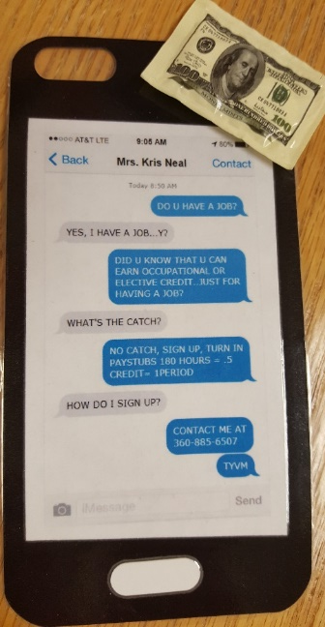
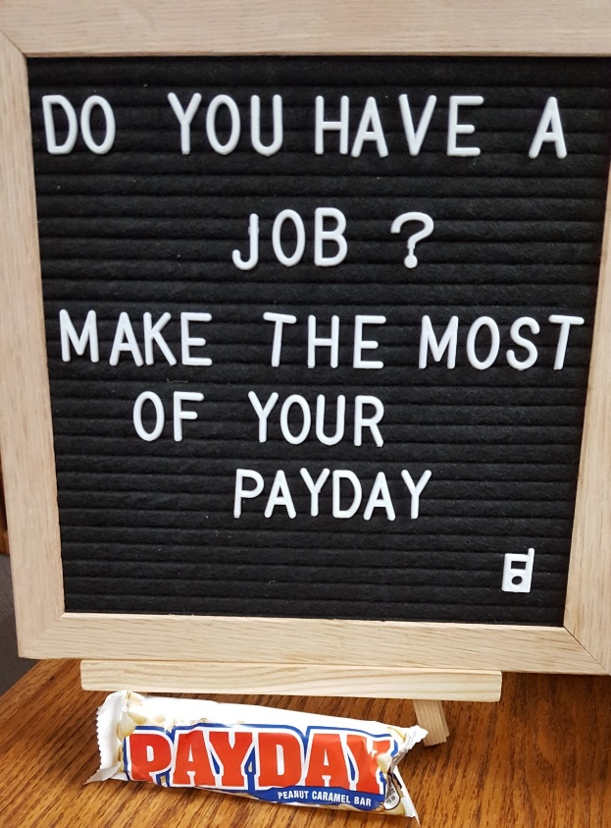
Advertising

Slide 12
Student Application Process

Slide 13
Contract, Questionnaire and Parent School Authorization
L & I
Parent School Authorization form

Slide 14
Work Based Learning Student Documentation

Slide 15
Learning Agreement
Job Site Paperwork
Site Qualification

Slide 16
Student Orientation
Initial Learning Plan

Slide 17
Evaluation

Slide 18
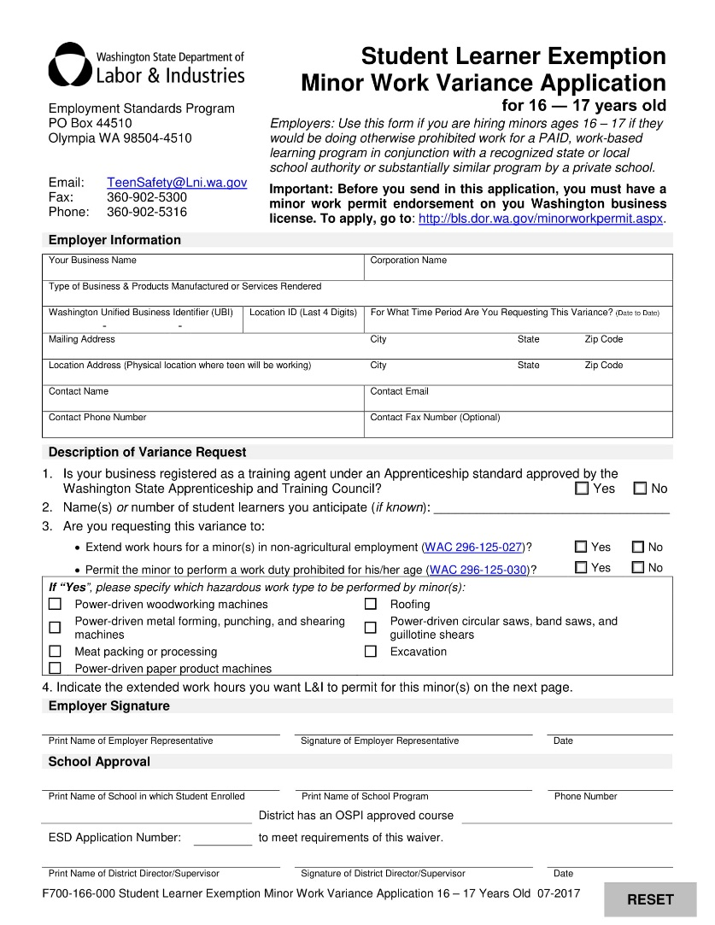
Minor Work Permit for Employers
Parent School Authorization
Student Learning Variance

Slide 19
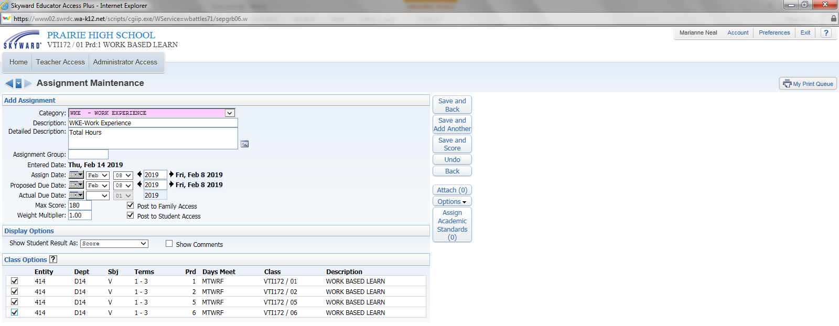
Skyward Grading

Slide 20
One assignment for the whole semester

Slide 21
Partnership-a mutually supportive relationship between a business and a school district in which the partners commit themselves to specific goals and activities intended to benefit students, schools and business
Partners In Business
Schools, Community and Business Working Together
General Advisory
Program Advisory
Work Site Learning
Internships
Job Shadow
Industry Fair
Career Fair
Mock Interviews

Slide 22
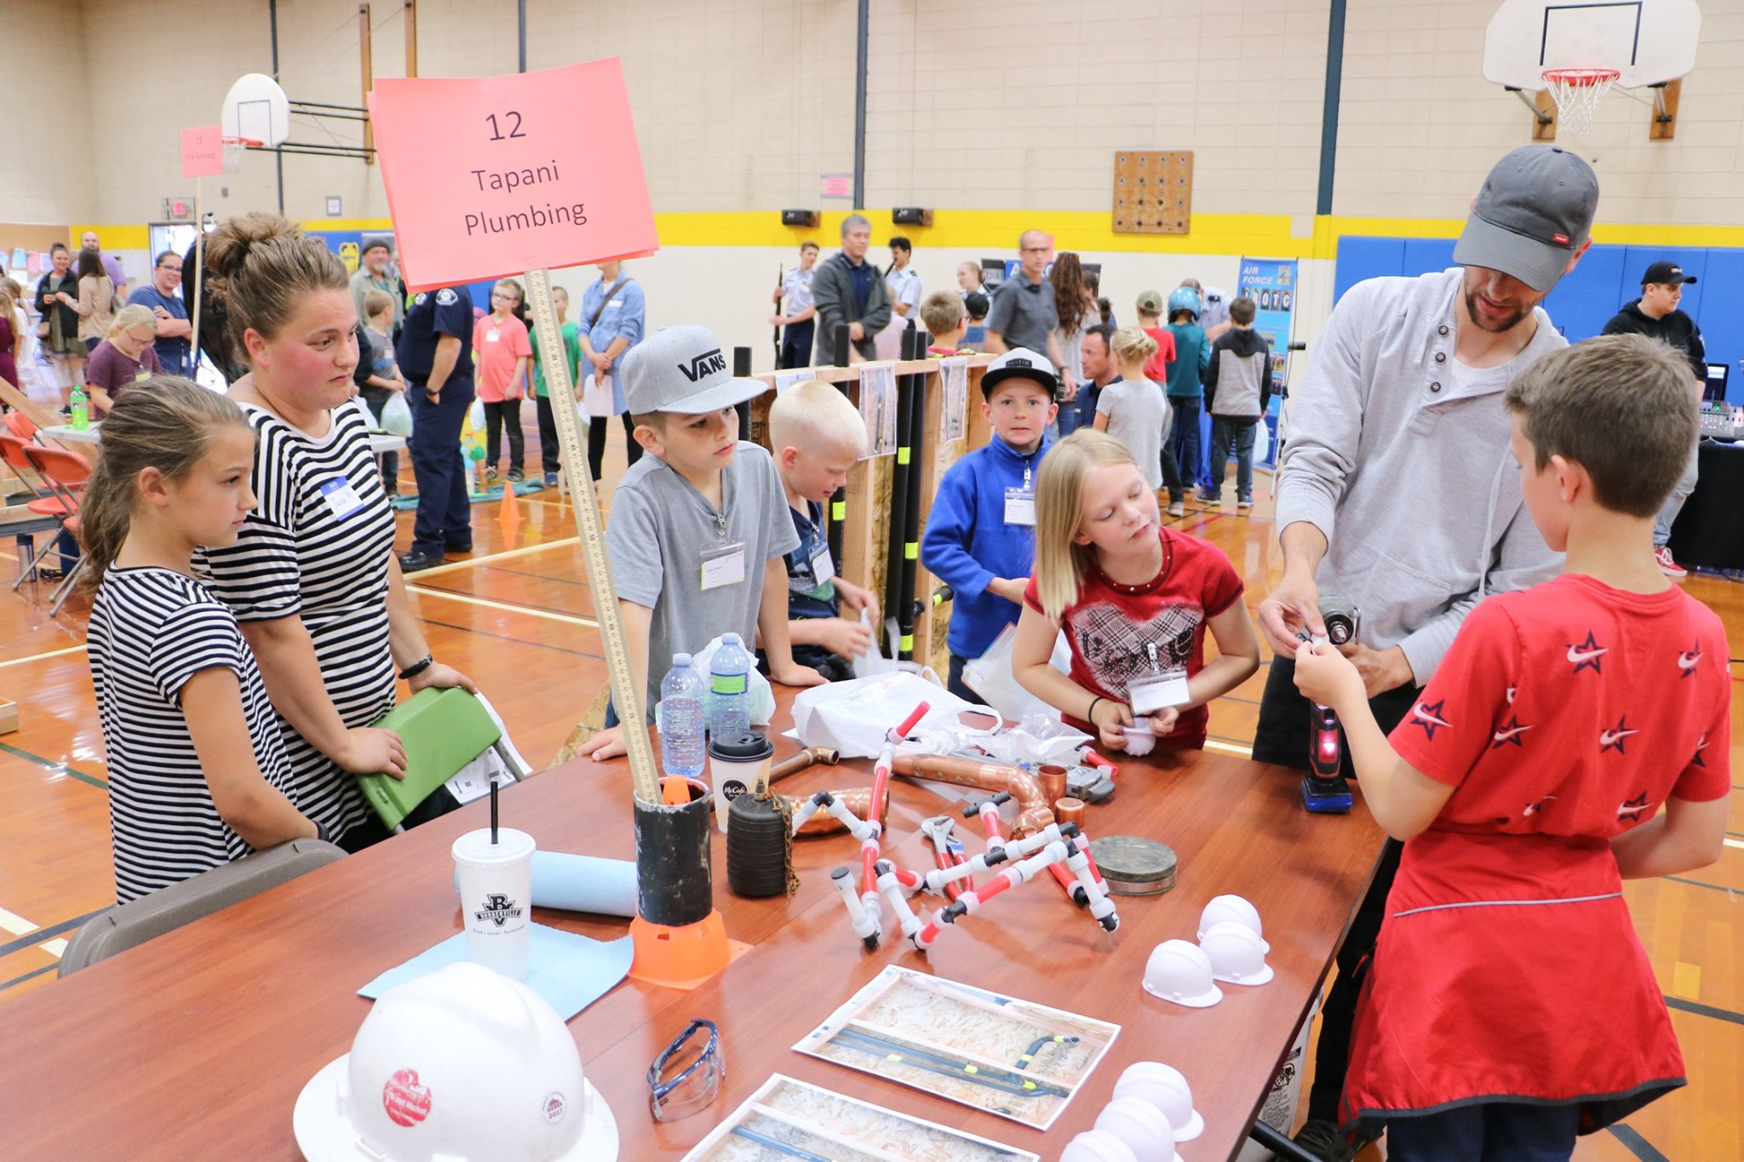
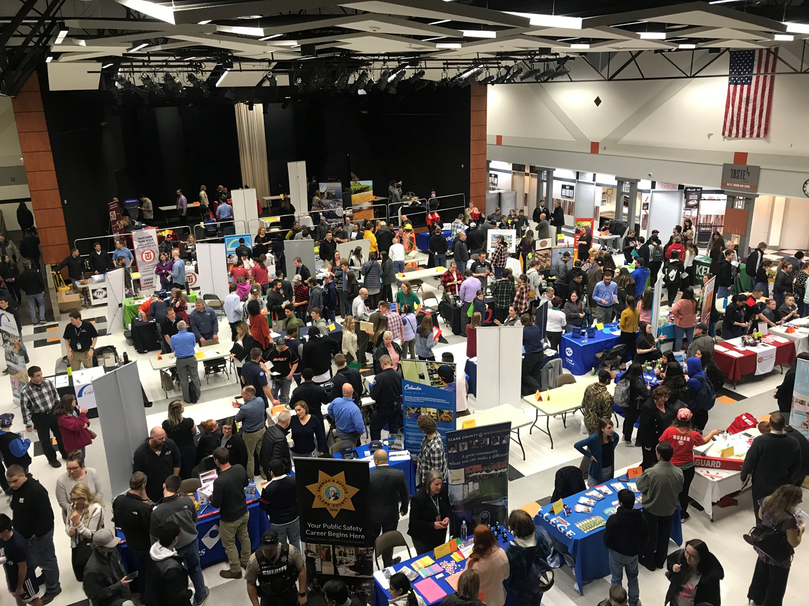
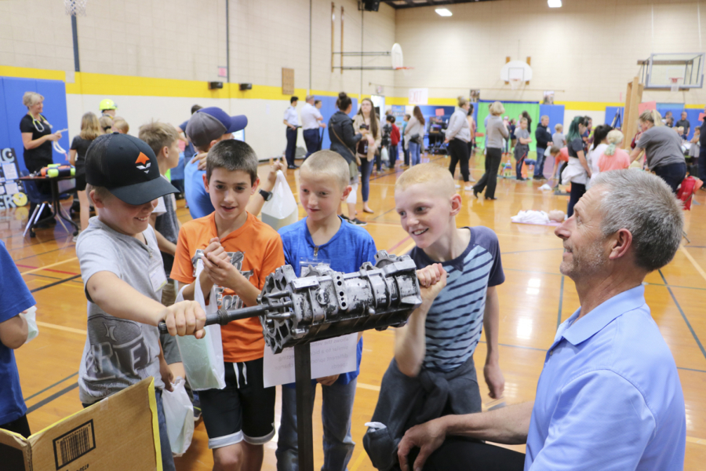

Slide 23
Student Records Management
The following are the essential elements of a student Worksite Learning file. These are required for audit compliance and connecting the experience to the student’s High School and Beyond Plan:
Worksite Learning Agreement
Evidence of site supervisor Program Orientation
Evidence of Employee Orientation
Worksite Learning Plans
Record of student hours
Record of connection to completed High School and Beyond Plan
Labor and Industries documents as required
Documentation of worksite qualification, site visits, and student evaluations

Slide 24
Evaluations & Learning Objectives
Make regular visits during grading period
Formal evaluation on students growth and assure that students are learning new skills on their learning plan
Meet with student to go over evaluation
Cooperative Worksite Learning experience are evaluated during and at end of Worksite experience
Instructional Worksite Learning experience are evaluated every 30 hours during the experience

Slide 25
End of Year Close Out Student Files
Final Evaluation
Check hours
Student file in order to archive
Give the Junior’s application for the next year
Give applications out from PSA Forms
Students that have forecasted for up coming school year
Write end of year report credits, hours, class, WD
Google Sheets

Slide 26
Resources
L & I Website
Parent School Authorization form
Student Learning Variance
OSPI- Work-Based Learning Handbook
OSPI - CIP Codes
Minor Work Permit
Google Sheets & Report

Slide 27
may

