Slide 1
The Rapidly Evolving American Labor Market & WorkSource

Slide 2
Who am I and why am I here?
Ben Compton, Career Connection Specialist for State of Washington
Military, college, vocational and administrative experience.
Government and corporate background in recruiting etc.
www.WorkSourceWa.com

Slide 3
What is WorkSource?
WorkSource is a statewide partnership of state, local and nonprofit agencies that provides an array of employment and training services to job seekers and employers
Washington State Employment Security Department (ESD) & partners
US Dept. of Labor
Where to go today and AFTER you graduate to get help with employment
www.WorkSourceWa.com

Slide 4
A labor market in crisis
The “automation” scare
Four generations
College graduate saturation
Vocational/trades shortage

Slide 5
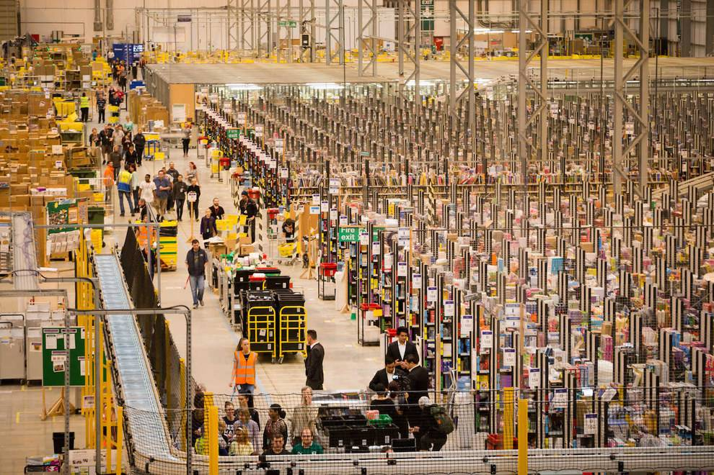
Big, BIG changes!
We are becoming an automated and service-based society.
For example:
Amazon…before…

Slide 6
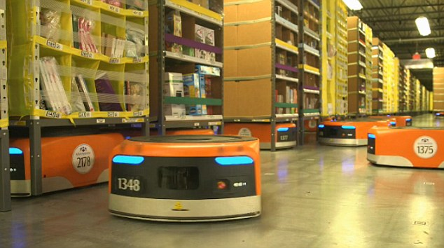
Amazon today!

Slide 7
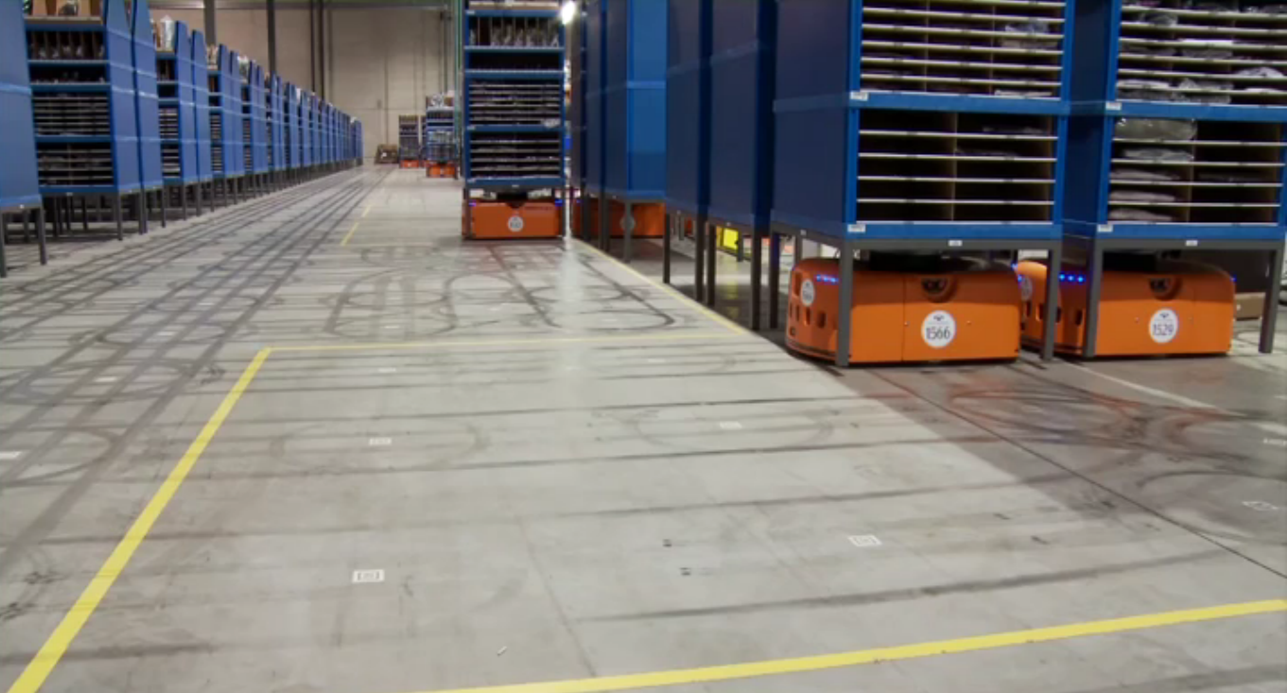

Slide 8
….no, not quite…

Slide 9
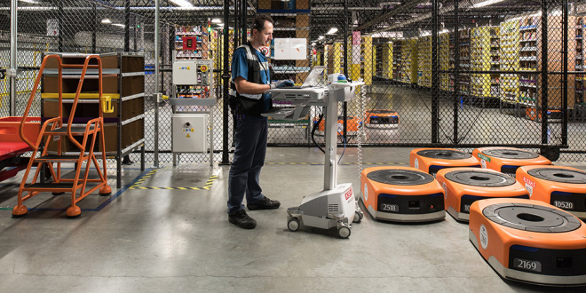
30,000 “Kiva” robots means they need people to service, maintain them

Slide 10
Autonomous vehicles

Slide 11
The four generations
Baby boomers, Gen X, Millennials & “Gen Z”

Slide 12
College grad & trades crisis
53% of US college grads unemployed or underemployed
7 million workers short (and growing!) in the trades

Slide 13
How we got here
“Just get any degree and…”
Message increased from the 1950s through the 1990s
“College ready”

Slide 14
In summary…
It’s an entirely different labor market
“Automation” scare = half the story
College, trades, military are EQUALLY valuable!

Slide 15
The traditional transition model
13+ years educational environment, then out into the labor market
SCHOOL
WorkSource/LABOR MARKET

Slide 16
The effective transition model
Introducing the current and predicted labor market to students prior to when they transition into it
SCHOOL
Work
Source/LABOR MARKET
What happens here is
important to understand

Slide 17
Supporting CTE
PSNS Work Study, Helper & Rad Con prep
Voc. Tech/trades interview prep
Washington Youth Academy
Justice involved youth
Various programs for challenges & barriers
Young Adult Hiring Events

Slide 18
Other resources…
Skills & abilities analysis
First resume
Job search strategies
Application essentials
Interview prep (including mock interviews)
On-site employers
WorkSource phone app
Federal application & resume
WorkSource is an equal opportunity employer/program. Auxiliary aids and services are available upon request to individuals with disabilities. Relay information Washington Relay Service: 711

Slide 19
Sources:
Federal Reserve Bank of New York
US Census Bureau (American Community Survey 2009, 2015, 2017)
Harvard Graduate School of Education’s “Pathways to Prosperity” research study
Georgetown University & Center on Education and the Workforce
US Bureau of Labor Statistics
Pew Research Center
US Dept. of Labor
Annual College Salary Report
Wall Street Journal Annual Salary Report
“Money and Career” magazine
Institute of Electrical and Electronics Engineers
Forbes

