Slide 1
Youth Job Retention Modern Labor Market, Modern Challenges

Slide 2
So you found a job…
Finding a job is meaningless if you
can’t keep it!

Slide 3
Main reasons for youth job loss
Any guesses?

Slide 4
#3 DISHONESTY
Shrinkage
Who does LP spend most time watching?
Getting harder to take from job
Companies spending more than ever on surveillance
Target
Most stores have well over 100 cameras
Auditing cash registers daily, shortages heavily scrutinized

Slide 5
Time theft is primary form
The top concern for most companies
Usually done casually
Even honest mistakes are getting people fired

Slide 6
#2 “Customer Service 101” (Attitude!)
“It’s not fair!”
Taking care of the customer
Drama through the door
Dress code (“What about my rights?”)

Slide 7
“Why?”
20% of high school students today have some sort of job, up from 16% during the recession. But…
60% in the 1980s
More pressure than ever to be college ready.
4 years English, 3 years science, 2 years foreign language has sextupled!

Slide 8
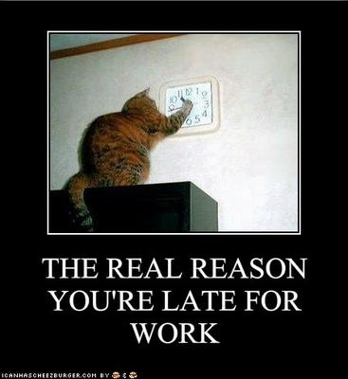
And the #1? ATTENDANCE!
Arriving late
No call/no show
Perpetually “sick”
“Car problems”

Slide 9
Other challenges regarding modern youth workers:
The job hopping contradiction
“I don’t want to work retail”
Public assistance vs. minimum wage

Slide 10
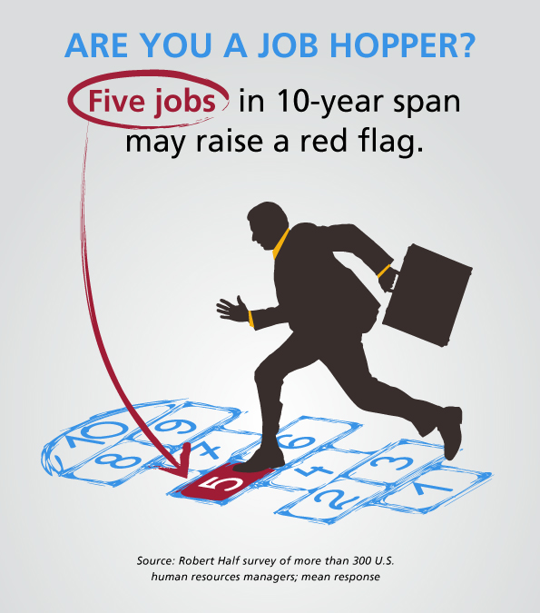
Job Hopping Then & Now/Gaps
Generations: Greatest to Gen Z
What we say vs. what we practice
Letting go of one rope without your hand on another

Slide 11
But I don’t want to work retail…
Why not?
Transferable skills to nearly every job
Safeway, Sportsman’s Warehouse, O’Reilly’s etc.

Slide 12
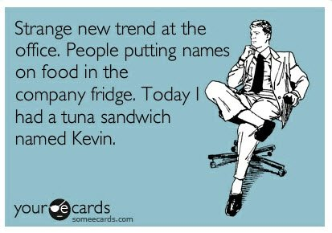
Working is always better!
Public assistance = 60 months
Even minimum wage is better!

Slide 13
…but let’s not forget:
1st generation to not put money first
Improvements to work environment quality
Strong feelings regarding contributing, community
Respect, rewarded for work

Slide 14
Questions?

