Slide 1
The Modern Youth Resume

Slide 2
Big Picture Presentation
Resumes are subjective by nature. I focus on “the big picture” using:
SOME national data (difficult)
Local data (2,500 employers)
Specific market/industry trends
Focusing on what is current!

Slide 3
Big Picture Presentation
What I do NOT use:
Google
Social media advice
Any one, specific industry or employer
MY own, unique opinion!
Notes:
Hardest to not use is my own opinion!

Slide 4
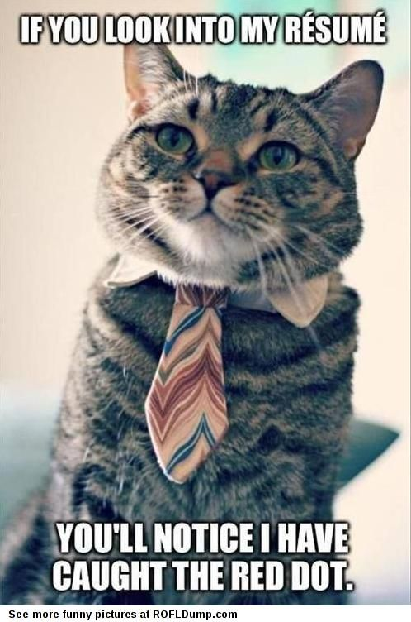
What is crucial for the student:
There is no “right way”!
Their opinion counts
It is not an overly technical document.

Slide 5
Old school: the chronological
The modern chronological resume began during the late 1940s
Was not common to have more than 2 jobs in a lifetime
Culture was about loyalty to the employer
Where have you been and what did you do there?
Notes:
The word “resume” became synonymous with chronological format

Slide 6
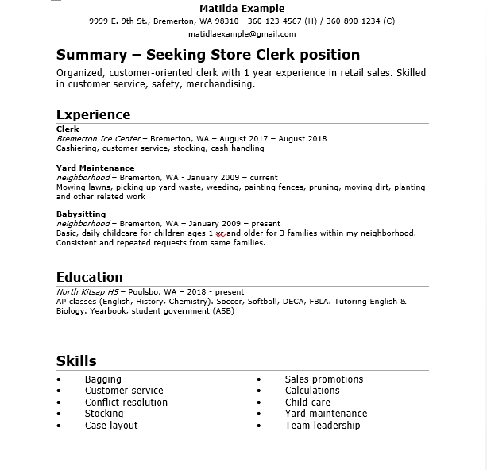
Notes:
The word “resume” became synonymous with chronological format

Slide 7
The importance of getting to the point
In 2007, the average employer spent 30 seconds glancing at a resume before making up their mind if they wanted to slow down and read it.
What is the national average today?
…………?

Slide 8
6 – 8 seconds!!

Slide 9
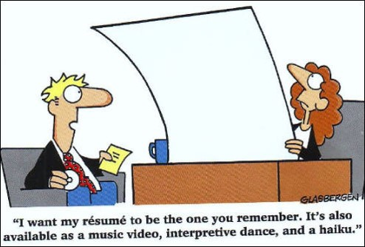
What matters is…
The employer can quickly locate the information that is important to them

Slide 10
Must be a “functional/skills-based” format.
Ideal for younger people who may not have a long work history (or may not have a work history at all!)
Allows them to specifically target employer’s needs using your skills and abilities
Do you know what I need and do you have it?

Slide 11
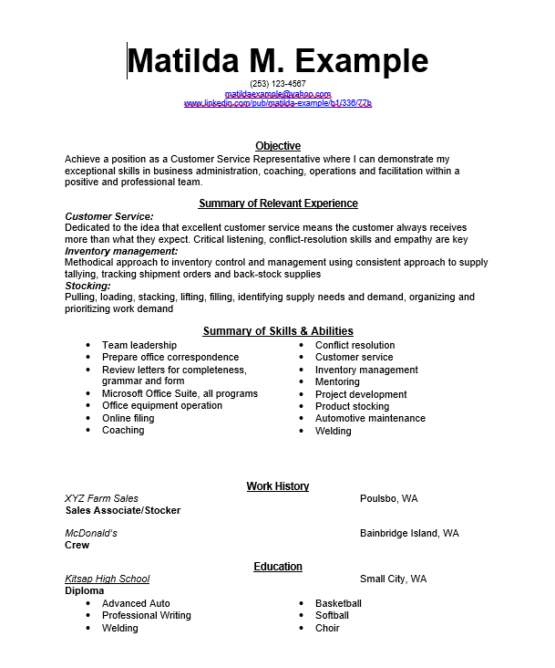

Slide 12
Students will still struggle identifying skills
O-Net! (www.onetonline.org)
Babysitting, yard care, moving etc.
Perfect for finding transferable skills
Notes:
Be realistic! As the employee, you may have to work a little harder sometimes. Might be more than only “half” way!

Slide 13
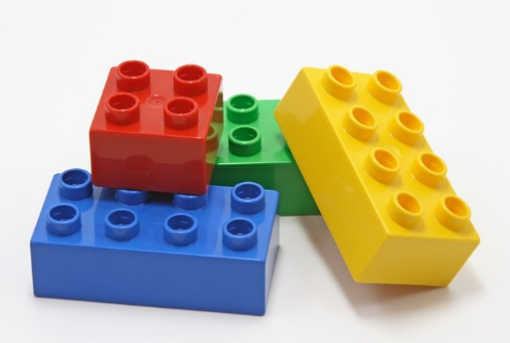
Putting it all together
Work on sections at a time (skills, education, volunteer work etc.)
Put them together in order of importance

Slide 14
Other sections are these important?
Volunteer activities *
Clubs/Sports
Certifications
Hobbies
Personal attributes
About Me (last resort)

Slide 15
Final points
One FULL page
Email address
Ring tone
Dates
Overdoing the bold, underlining, italics and bullets
Cambria, Helvetica, Times New Roman or Arial
Templates & Resume Builders
References

Slide 16
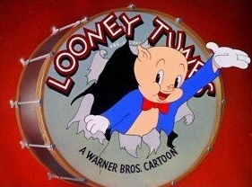
Thank you for attending!

